Slide 1
Parallel Programming in Python – a very, very short introduction
Agenda
Computer architectures, data structures, and opportunities
Case 1 – computing a distance matrix
Case 2 – computing the average of a large sample

Slide 2
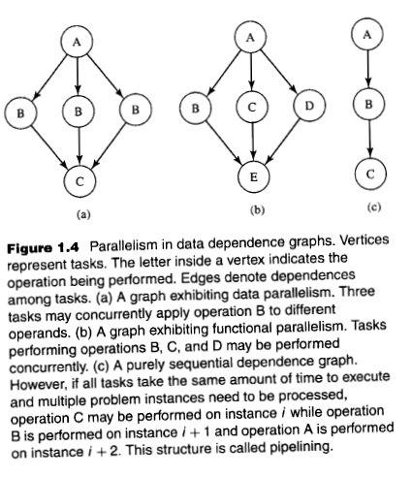
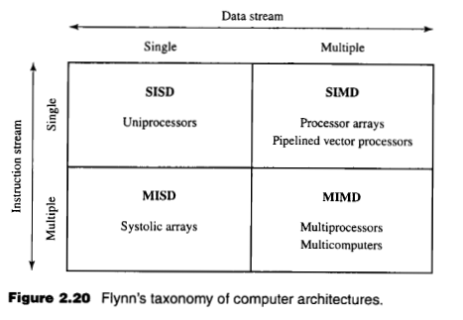
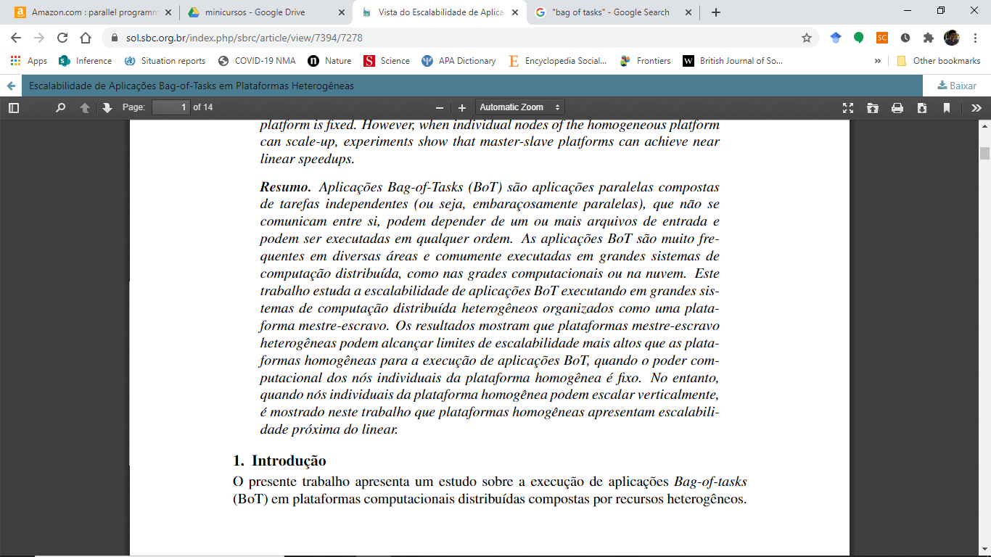


The scope of the technique that will be presented [1]:
[2]

Slide 3

Case 1 – computing a distance matrix

Slide 4
Case 1 - computing a distance matrix, sequential scheme
d-dimensional vectors
v1
v2
v3
vk
v1
v1
v1
v1
v2
v2
v2
v3
v3
tasks
v2
v3
vk
v3
vk
vk
vk
v1
v2
v3
vk
v1
0
Sequential execution, process P1
v2
0
v
distance matrix
v3
0
0
vk
v
0
distance matrix

Slide 5
Case 1 - computing a distance matrix, parallel scheme
d-dimensional vectors
v1
v2
v3
vk
v1
v1
v1
v1
v2
v2
v2
v3
v3
tasks
v2
v3
vk
v3
vk
vk
vk
v1
v2
v3
vk
v1
0
Parallel execution
process P1
Parallel execution
process P2
v2
0
v
distance matrix
v3
0
0
vk
v
0
distance matrix

Slide 6
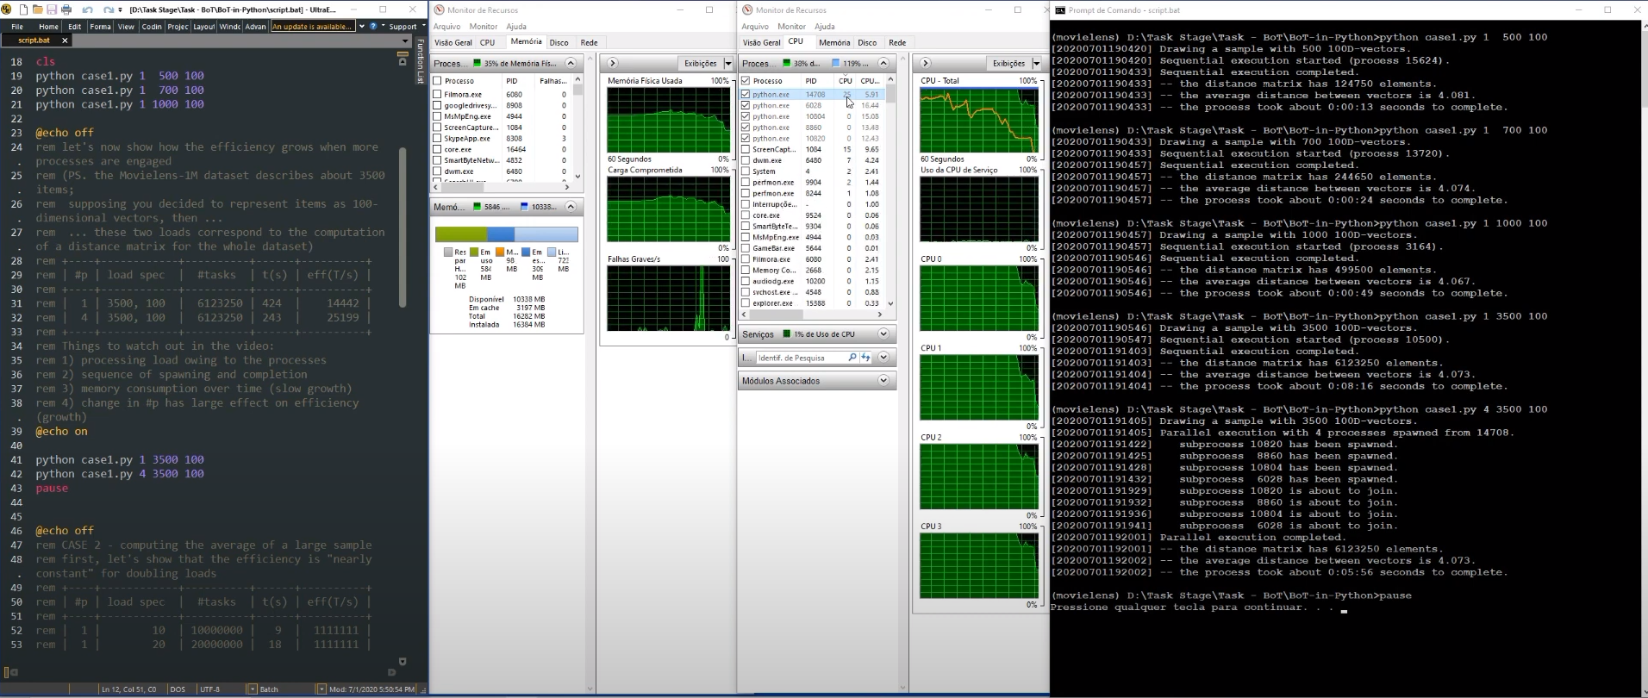
Case 1 - computing a distance matrix, sequential scheme
Link para o vídeo

Slide 7
Case 2 – computing the average of a large sample

Slide 8
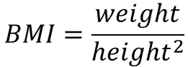
Case 2 - computing the average of a large sample, sequential scheme
Attributes obtained from the same individual
(sampled from the Brazilian male population, 1977 [3])
height
weight
Sequential execution, process P1
$$BMI=\frac{weight}{{height}^{2}}$$
BMI

Slide 9
Case 2 - computing the average of a large sample, parallel scheme
Attributes obtained from the same individual
(sampled from the Brazilian male population, 1977 [3])
height
weight
Parallel execution
process P1
Parallel execution
process P2
Parallel execution
process P3
Parallel execution
process P4
$$BMI=\frac{weight}{{height}^{2}}$$
BMI

Slide 10
Case 2 - computing the average of a large sample, statistical scheme
Attributes obtained from the same individual
(sampled from the Brazilian male population, 1977 [3])
height
weight
Sequential execution, process P1
$$BMI=\frac{weight}{{height}^{2}}$$
BMI

Slide 11
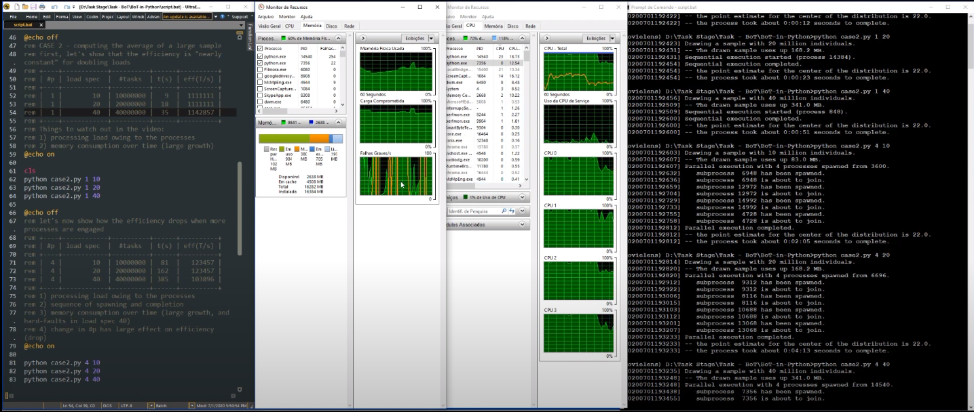
Case 2 - computing the average of a large sample
Link para o vídeo

Slide 12
Case 3 – TBD

Slide 13
To be resumed in a future meeting ;)

Slide 14
Parallel Programming in Python – a very, very short introduction
Thanks!

Slide 15
Parallel Programming in Python – a very, very short introduction
References:
[1] Quinn, Michael. "Parallel Programming in C with MPI and OpenMP", McGraw-Hill Science, ISBN 9780072822564, 2003.
[2] de Souza, Jaime Freire, Hermes Senger, and Fabricio AB Silva. "Escalabilidade de Aplicações Bag-of-Tasks em Plataformas Heterogêneas." In Anais Principais do XXXVII Simpósio Brasileiro de Redes de Computadores e Sistemas Distribuídos, pp. 664-677. SBC, 2019.
[3] Guimaraes, M. I. C. C., & Sordi, G. M. A. A. (1995). Desenvolvimento do manequim matemático do homem brasileiro para cálculos de dosimetria interna. Tese de Doutorado. Instituto de Pesquisas Energéticas e Nucleares (IPEN) - Universidade de São Paulo, São Paulo.
# (see page 29; uses data that were collected by IBGE back in 1976/1977)

Slide 16
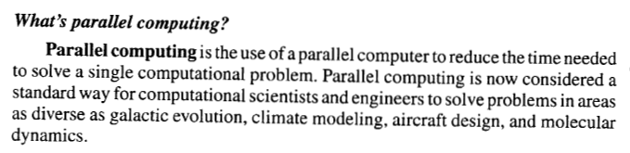
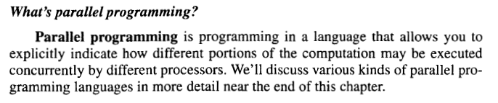

Slide 18
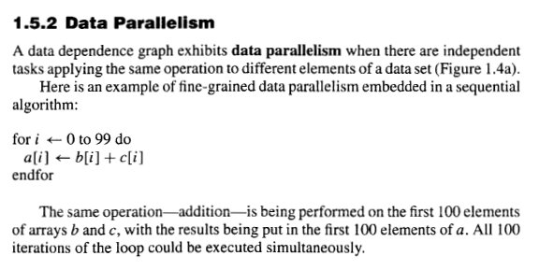
Bag of Tasks

